Slide 1
Session: 2021- 2022
Event Name | Date | No. of Participants | Description
State Level Geo- Photography Contest | 19/8/2021 | 118 | Students and Research Scholars from different schools, colleges and universities have participated the contest where they have to upload photographs that are geographically significant.
Webinar | 2/10/2021 | 67 | The webinar has been held in collaboration with the Department of Remote Sensing, GIS and Earth Sciences on “Remote Sensing and GIS: A Measure to Enhance the Productivity of Geographical Study”; Speaker: Dr. Ratnadeep Roy.
Webinar | 20/12/2021 | 97 | The webinar was on the topic of “Data and Techniques of Hazard Mapping”; Speaker: Prof. (Dr.) Shashanka Kumar Gayen
Intra- departmental Debate and Quiz Contest and Online Poster Making Contest | 22/04/2022 | 117 | The event was celebrated to observe World Earth Day. The online contest was being organized in collaboration with Government Girls’ General Degree College
Online Craft making contest from Waste Material | 05/06/2022 | 15 | To observe the World Environment Day virtually, participants uploaded the image of their self made craft work prepared from the regular domestic waste materials.
Seminar | 14/06/2022 | 103 | A seminar on Remote Sensing and GIS has been organized to enrich the students with the eminent speaker Dr. Ratnadeep Ray, JIS University.
Webinar | 28/06/2022 | 68 | A webinar on Biodiversity at the Heart of Sustainable Development with the eminent speaker Dr. Kasturi Mukherjee, Adamas University

Slide 2
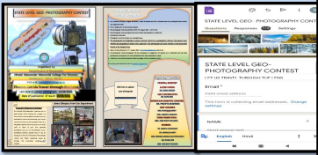
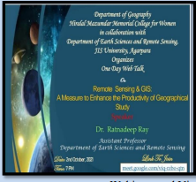
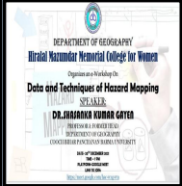
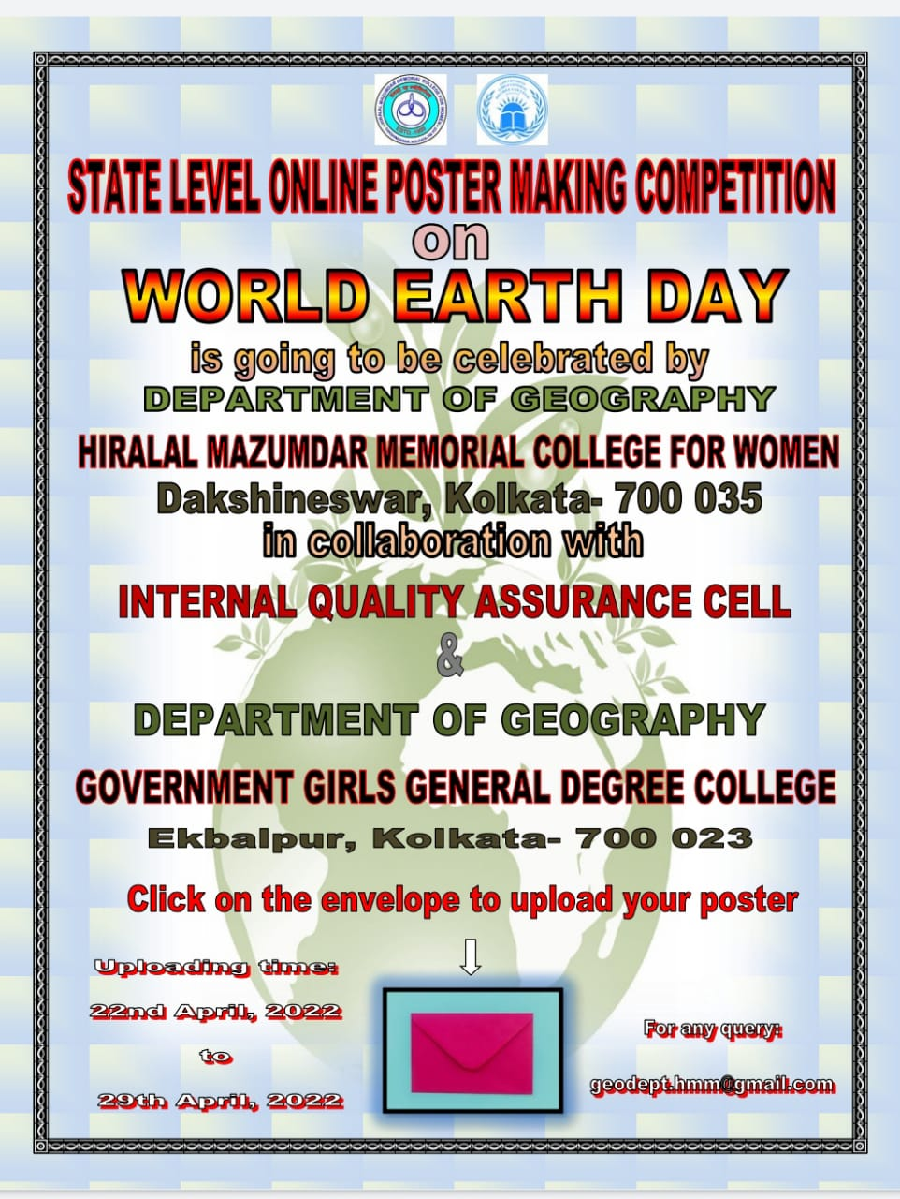
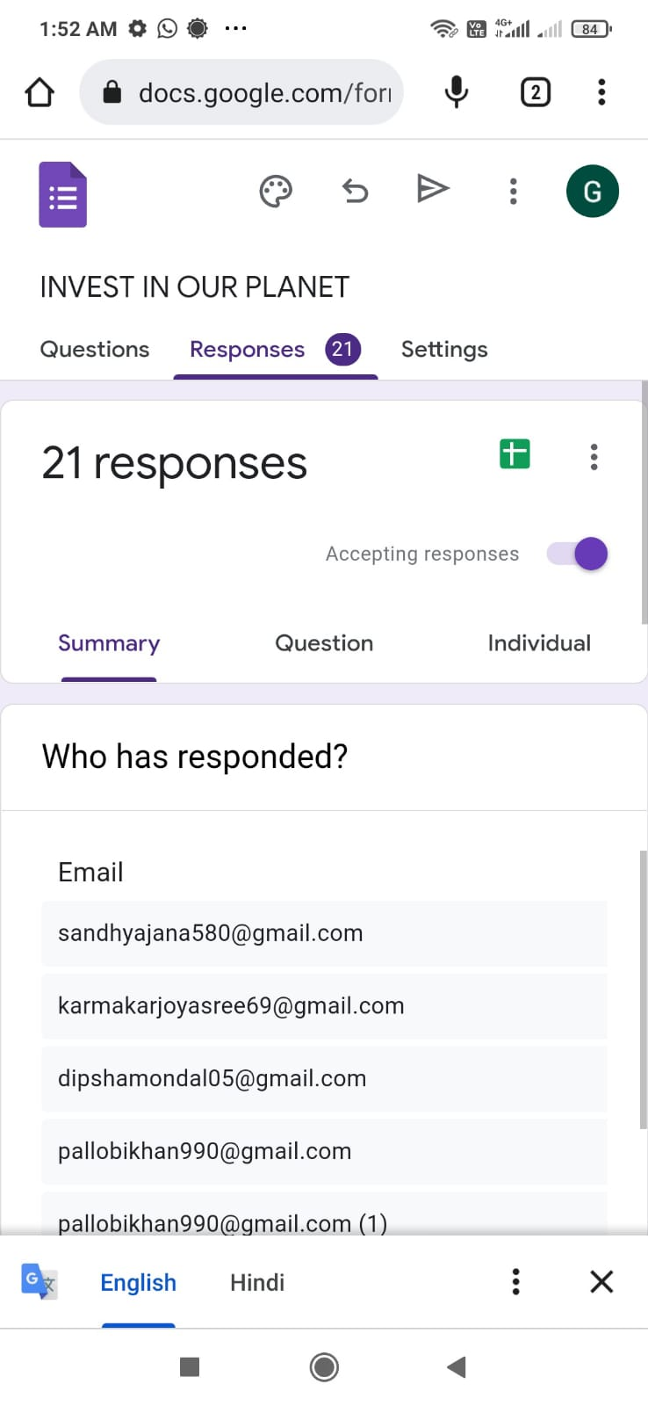
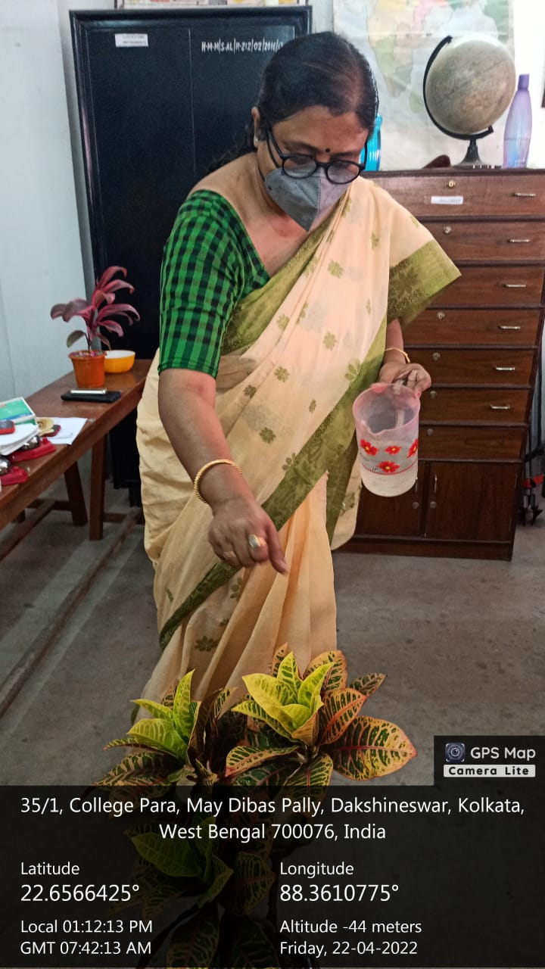
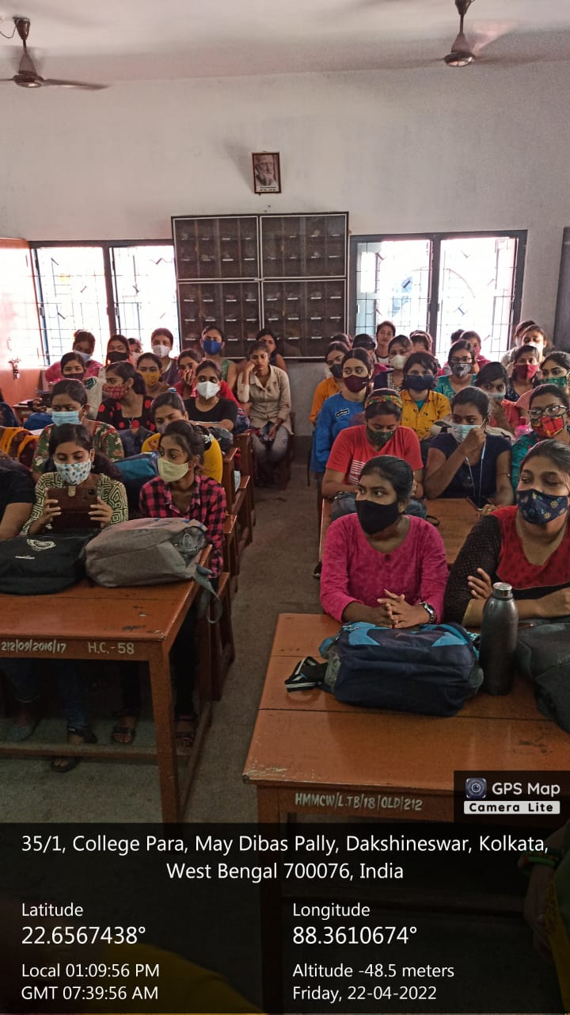
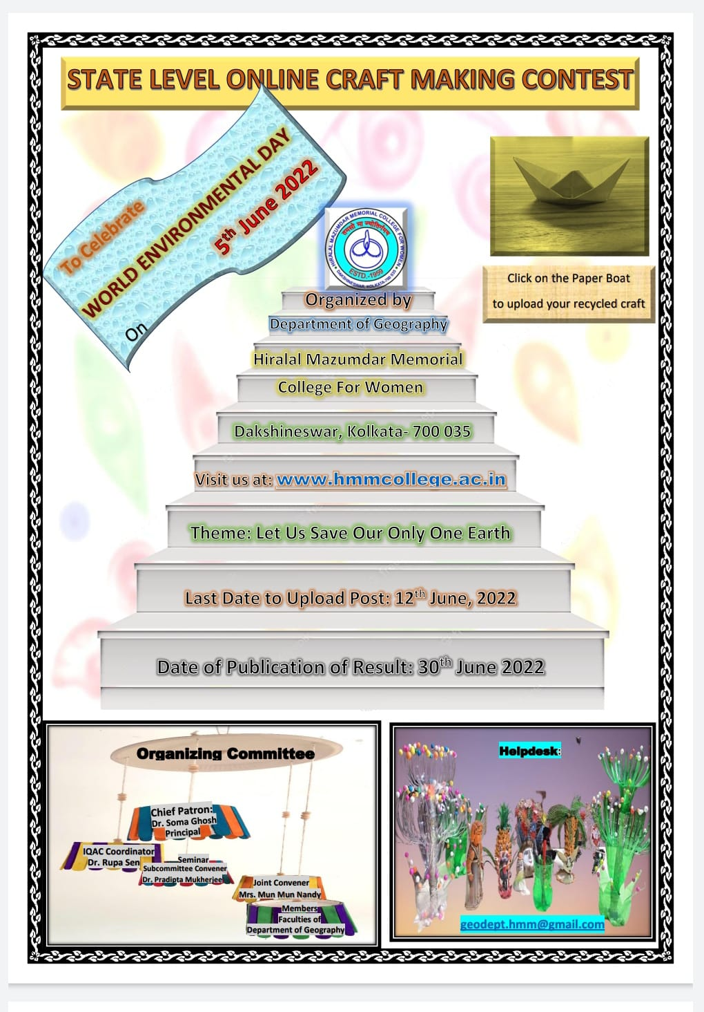
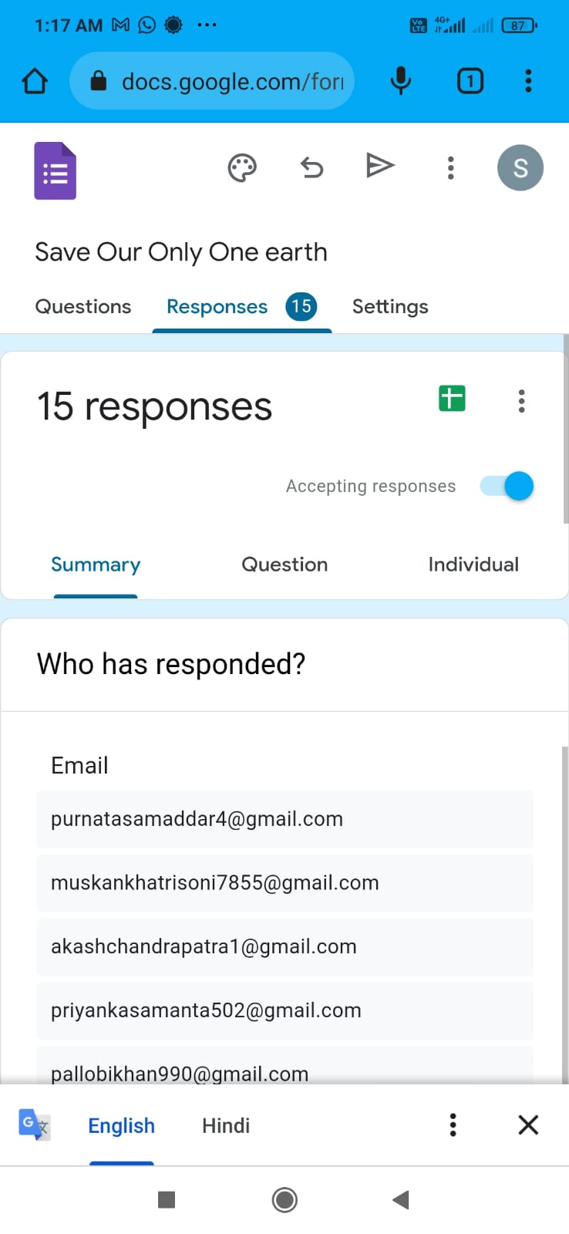
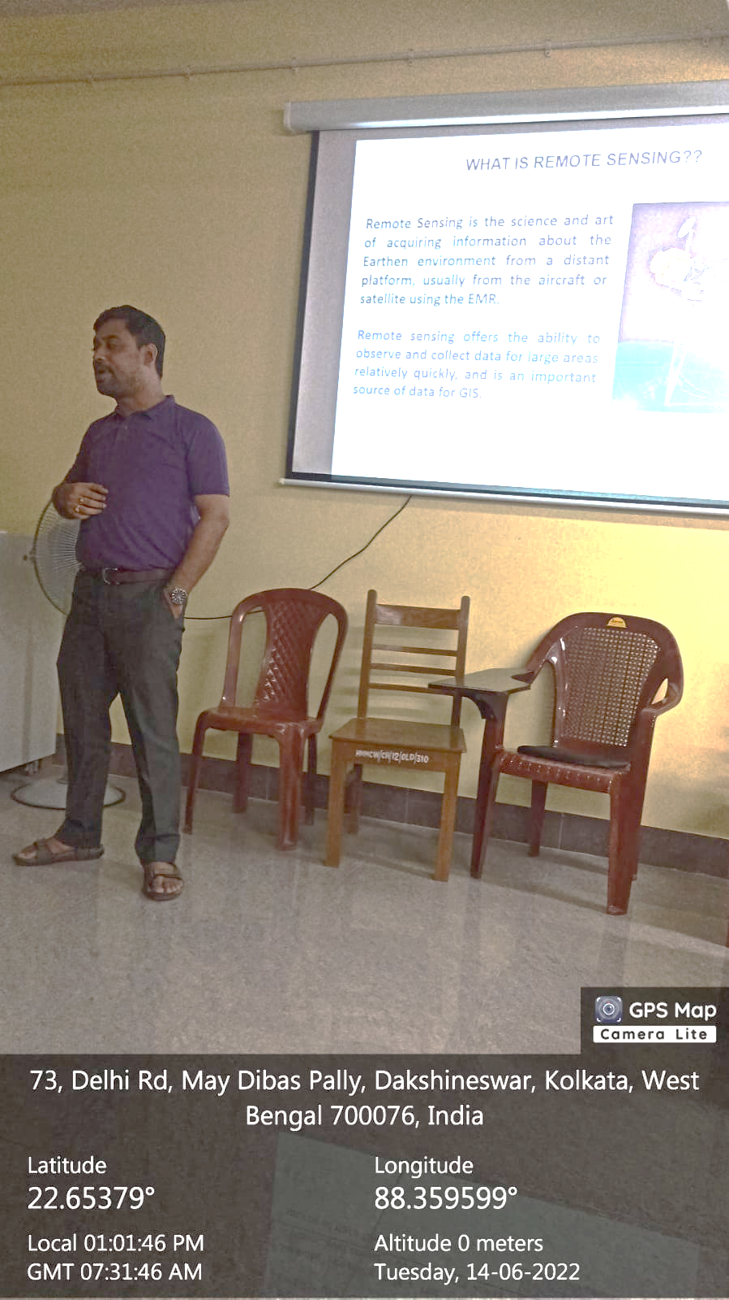
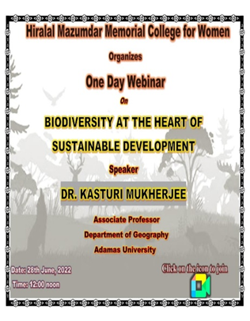
CORRESPONDING PHOTOS WITH EVENT NAME:
Popular Talk by
Dr. Ratnadeep Ray
Webinar with
Dr. S. K. Gayen
World Earth Day
Online Observation
Geo- Photography Contest
World Earth Day
Offline Observation
Online Craft making Contest
Seminar by
Dr. Ratnadeep Ray
Webinar with
Dr. Kasturi Mukherjee

